Slide 1


Customer Journeys:
SQL Data Generator and Data Masker

Slide 2





About me
Chris Unwin
Solutions Architect
& Data Security Fan
@PlantBasedSQL
DBAle on the Redgate Hub

Slide 3

Agenda
Synthetic Data and De-Identified Data
Redgate Solution Components
Data Generation and Masking in action
Notes:
Image: https://images.unsplash.com/photo-1518976024611-28bf4b48222e?ixlib=rb-1.2.1&ixid=eyJhcHBfaWQiOjEyMDd9&auto=format&fit=crop&w=632&q=80

Slide 4
Synthesized Data
De-Identified Data
Generated from scratch
Every column receives data
Generate as much as you want
No stats retained
Great for development
Overwrites existing data
Only specify are changed
Number of rows remains constant
Can retain distribution
Great for development

Slide 5
Synthesized Data
De-Identified Data
ID | Name | DOB
1 | Chris | 16-10-1991
ID | Name | DOB
1 | Chris | 16-10-1991
ID | Name | DOB
ID | Name | DOB
1 | Steve | 30-09-1991
ID | Name | DOB
90 | Joan | 29-3-2001
91 | Phil | 01-01-1976
92 | Mavis | 12-12-1999

Slide 6

Synthesized Data Use Cases
Load Testing / Scaling
Quick dev testing
Fast, flexible data

Slide 7

De-Identified Data Use Cases
Protect PII
Preserve distributions and statistics
Useful business insight and bug hunting

Slide 8

Solutions in action
Notes:
Image: https://images.unsplash.com/photo-1485846234645-a62644f84728?ixlib=rb-1.2.1&ixid=eyJhcHBfaWQiOjEyMDd9&auto=format&fit=crop&w=1340&q=80

Slide 9
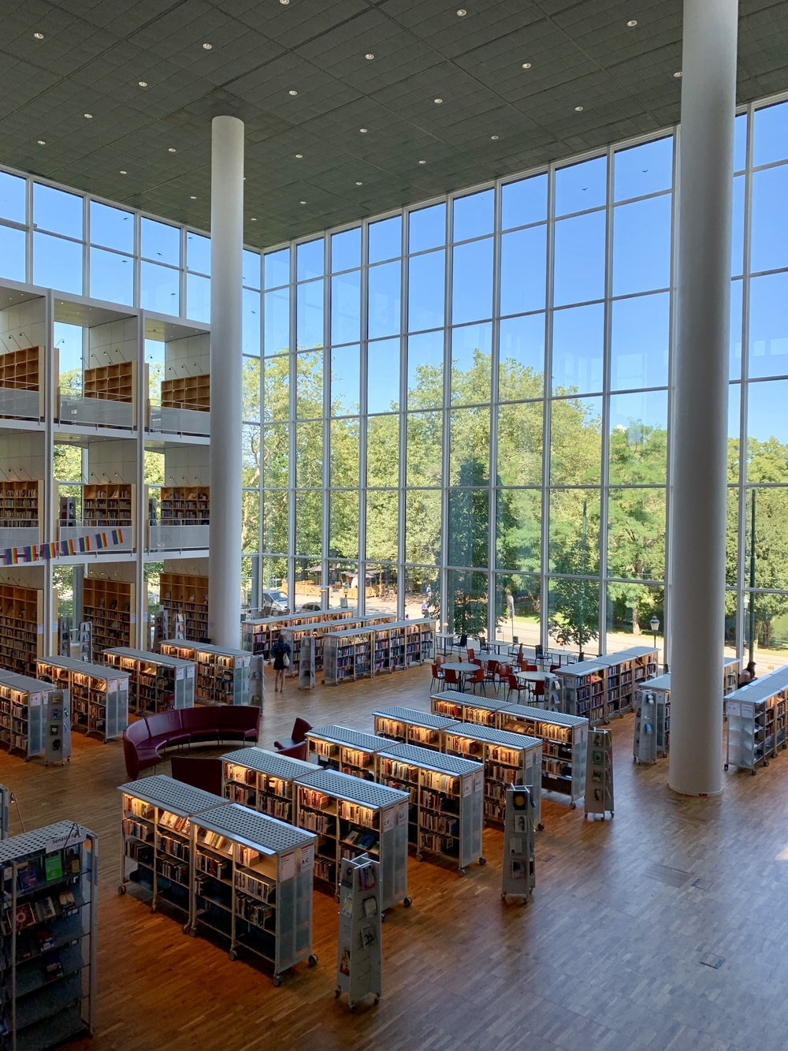
Resources
These slides: https://bit.ly/37xQU8j
Data Masker: https://www.red-gate.com/products/dba/data-masker/
SQL Data Generator: https://www.red-gate.com/products/sql-development/sql-data-generator/
Redgate Hub: https://www.red-gate.com/hub/
Notes:
Image: https://images.unsplash.com/photo-1564910443496-5fd2d76b47fa?ixlib=rb-1.2.1&ixid=eyJhcHBfaWQiOjEyMDd9&auto=format&fit=crop&w=675&q=80

